Slide 1
How Tall the Triangle?
Penguin book of Puzzles

Slide 2







How Tall the Triangle?
$$C$$
Triangle $ABC$ is an equilateral triangle.
Three perpendiculars, with lengths shown, are drawn that meet at a point.
How tall is the triangle?
(NOT to scale)
$$6$$
$$3$$
$$8$$
$$A$$
$$B$$

Slide 3



How Tall the Triangle?
$$C$$
Let’s look at the general case.
(NOT to scale)
$$b$$
$$c$$
$$a$$
$$A$$
$$B$$

Slide 4





How Tall the Triangle?
$$C$$
(NOT to scale)
$$b$$
$$c$$
$$60°$$
$$\frac{b}{\sin{60°}}$$
$$\frac{c}{\sin{60°}}$$
$$a$$
$$A$$
$$B$$

Slide 5
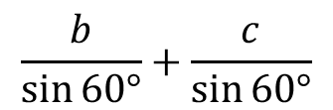
How Tall the Triangle?
$$C$$
(NOT to scale)
$$b$$
$$c$$
$$60°$$
$$\frac{b}{\sin{60°}}$$
$$\frac{c}{\sin{60°}}$$
$$a$$
$$A$$
$$B$$
$$\frac{b}{\sin{60°}}+\frac{c}{\sin{60°}}$$

Slide 6
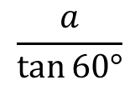


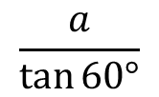
How Tall the Triangle?
$$C$$
(NOT to scale)
$$b$$
$$c$$
$$60°$$
$$a$$
$$a$$
$$a$$
$$A$$
$$B$$
$$\frac{a}{\tan{60°}}$$
$$\frac{b}{\sin{60°}}+\frac{c}{\sin{60°}}$$
$$\frac{a}{\tan{60°}}$$

Slide 7
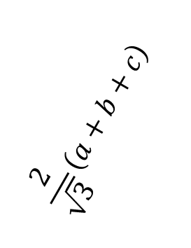
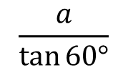
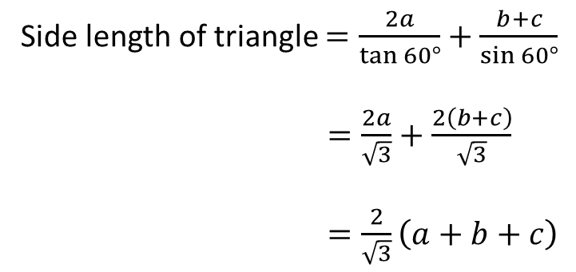
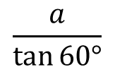


How Tall the Triangle?
$$C$$
Side length of triangle $=\frac{2a}{\tan{60°}}+\frac{b+c}{\sin{60°}}$
$=\frac{2a}{\sqrt{3}}+\frac{2\left(b+c\right)}{\sqrt{3}}$
$=\frac{2}{\sqrt{3}}\left(a+b+c\right)$
(NOT to scale)
$$\frac{2}{\sqrt{3}}\left(a+b+c\right)$$
$$b$$
$$c$$
$$a$$
$$A$$
$$B$$
$$\frac{b}{\sin{60°}}+\frac{c}{\sin{60°}}$$
$$\frac{a}{\tan{60°}}$$
$$\frac{2}{\sqrt{3}}\left(a+b+c\right)$$
$$\frac{a}{\tan{60°}}$$

Slide 8
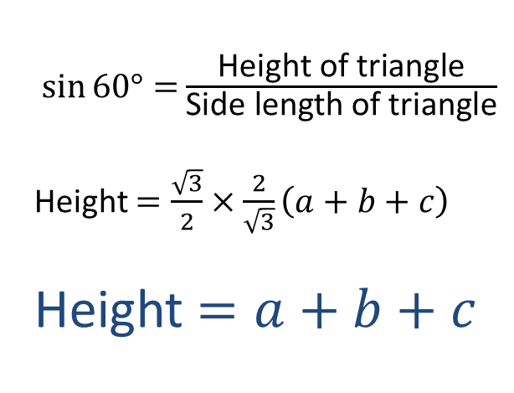
How Tall the Triangle?
$$C$$
$\sin{60°=}\frac{\text{Height} \text{of} \text{triangle}}{\text{Side} \text{length} \text{of} \text{triangle}}$
Height $=\frac{\sqrt{3}}{2}×\frac{2}{\sqrt{3}}\left(a+b+c\right)$
Height $=a+b+c$
(NOT to scale)
$$\frac{2}{\sqrt{3}}\left(a+b+c\right)$$
$$b$$
$$c$$
$$a$$
$$A$$
$$B$$
$$\frac{2}{\sqrt{3}}\left(a+b+c\right)$$

Slide 9

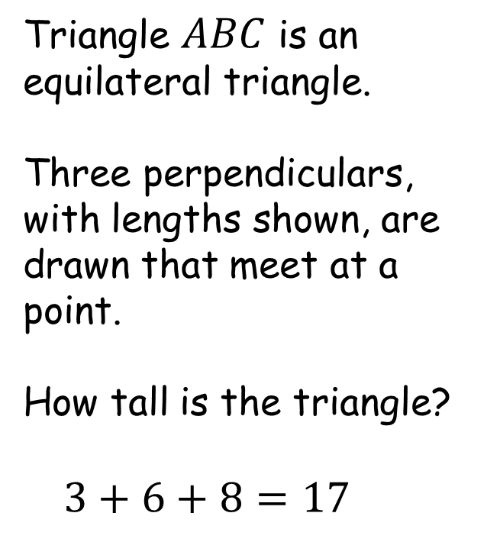
How Tall the Triangle?
$$C$$
Triangle $ABC$ is an equilateral triangle.
Three perpendiculars, with lengths shown, are drawn that meet at a point.
How tall is the triangle?
$3+6+8=17$
(NOT to scale)
$$17$$
$$6$$
$$3$$
$$8$$
$$A$$
$$B$$

Slide 11
NOTE TO TEACHER
SIC_75
The sum of the perpendicular lengths to a common point in an equilateral triangle is the height of the triangle.

Slide 12
RESOURCES

Slide 13


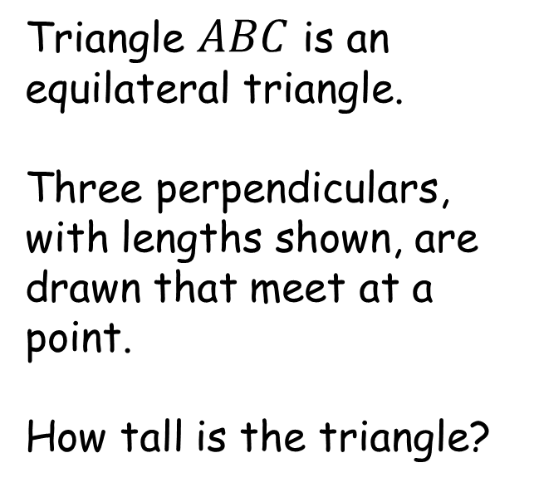

How Tall the Triangle?
$$C$$
Triangle $ABC$ is an equilateral triangle.
Three perpendiculars, with lengths shown, are drawn that meet at a point.
How tall is the triangle?
(NOT to scale)
$$4$$
$$3$$
$$8$$
$$A$$
$$B$$
SIC_75

Slide 14


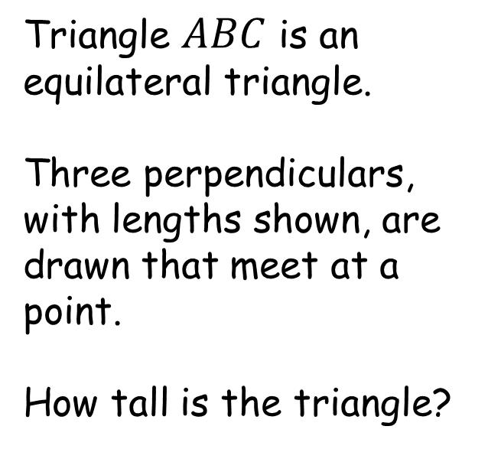
How Tall the Triangle?
$$C$$
Triangle $ABC$ is an equilateral triangle.
Three perpendiculars, with lengths shown, are drawn that meet at a point.
How tall is the triangle?
(NOT to scale)
$$7$$
$$2$$
$$8$$
$$A$$
$$B$$
SIC_75

Slide 15

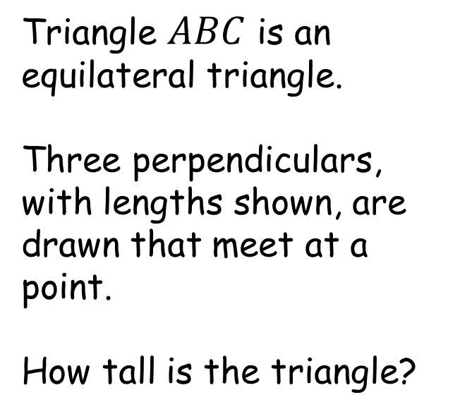

How Tall the Triangle?
$$C$$
Triangle $ABC$ is an equilateral triangle.
Three perpendiculars, with lengths shown, are drawn that meet at a point.
How tall is the triangle?
(NOT to scale)
$$9$$
$$3$$
$$6$$
$$A$$
$$B$$
SIC_75

Slide 16


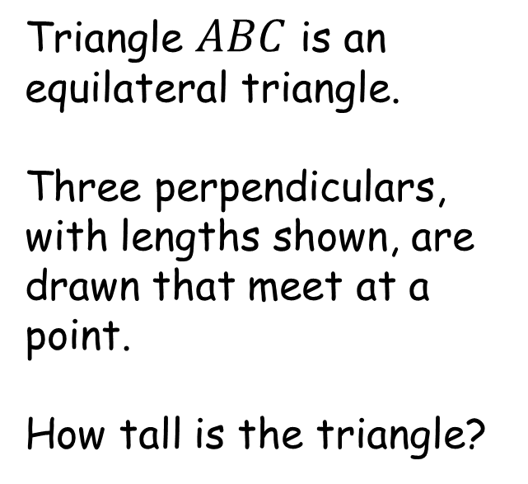

How Tall the Triangle?
$$C$$
Triangle $ABC$ is an equilateral triangle.
Three perpendiculars, with lengths shown, are drawn that meet at a point.
How tall is the triangle?
(NOT to scale)
$$10$$
$$7$$
$$11$$
$$A$$
$$B$$
SIC_75

Slide 17

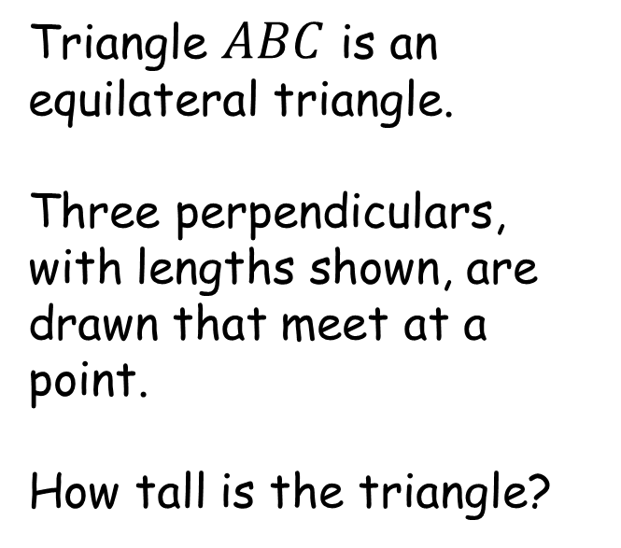
How Tall the Triangle?
$$C$$
Triangle $ABC$ is an equilateral triangle.
Three perpendiculars, with lengths shown, are drawn that meet at a point.
How tall is the triangle?
(NOT to scale)
$$5$$
$$2$$
$$8$$
$$A$$
$$B$$
SIC_75

Slide 18



How Tall the Triangle?
$$C$$
Triangle $ABC$ is an equilateral triangle.
Three perpendiculars, with lengths shown, are drawn that meet at a point.
How tall is the triangle?
(NOT to scale)
$$3$$
$$1$$
$$4$$
$$A$$
$$B$$
SIC_75

Slide 19

How Tall the Triangle?
$$C$$
Triangle $ABC$ is an equilateral triangle.
Three perpendiculars, with lengths shown, are drawn that meet at a point.
How tall is the triangle?
(NOT to scale)
$$8$$
$$2$$
$$4$$
$$A$$
$$B$$
SIC_75

Slide 20



How Tall the Triangle?
$$C$$
Triangle $ABC$ is an equilateral triangle.
Three perpendiculars, with lengths shown, are drawn that meet at a point.
How tall is the triangle?
(NOT to scale)
$$11$$
$$8$$
$$12$$
$$A$$
$$B$$
SIC_75

Slide 21

How Tall the Triangle?
$$C$$
Triangle $ABC$ is an equilateral triangle.
Three perpendiculars, with lengths shown, are drawn that meet at a point.
How tall is the triangle?
(NOT to scale)
$$4$$
$$3$$
$$5$$
$$A$$
$$B$$
SIC_75

Slide 22

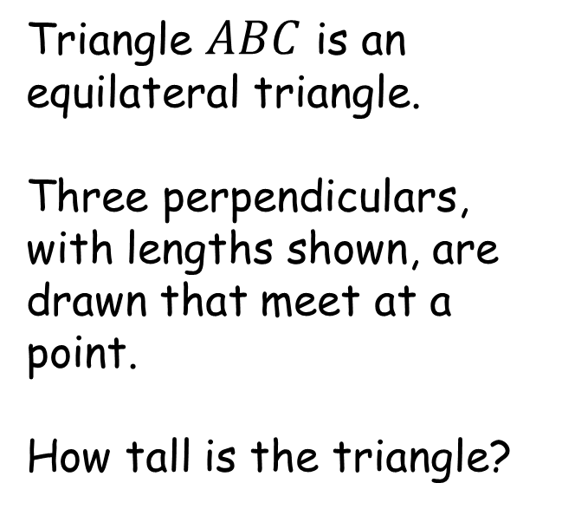
How Tall the Triangle?
$$C$$
Triangle $ABC$ is an equilateral triangle.
Three perpendiculars, with lengths shown, are drawn that meet at a point.
How tall is the triangle?
(NOT to scale)
$$6$$
$$2$$
$$8$$
$$A$$
$$B$$
SIC_75

Slide 23
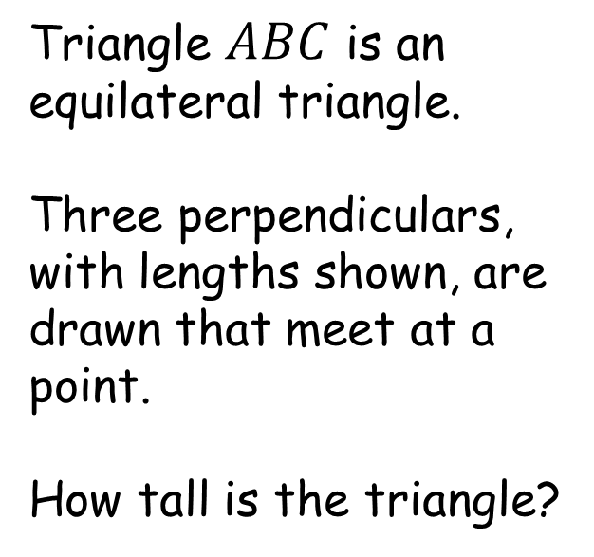

How Tall the Triangle?
$$C$$
Triangle $ABC$ is an equilateral triangle.
Three perpendiculars, with lengths shown, are drawn that meet at a point.
How tall is the triangle?
(NOT to scale)
$$9$$
$$3$$
$$7$$
$$A$$
$$B$$
SIC_75

Slide 24
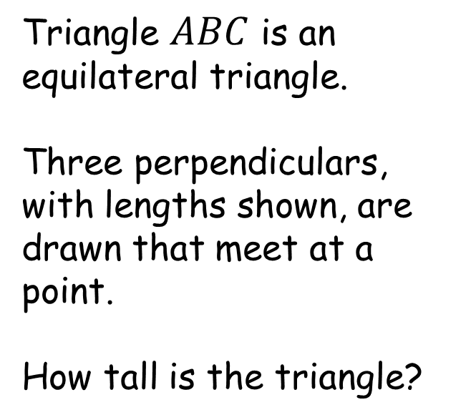
How Tall the Triangle?
$$C$$
Triangle $ABC$ is an equilateral triangle.
Three perpendiculars, with lengths shown, are drawn that meet at a point.
How tall is the triangle?
(NOT to scale)
$$10$$
$$7$$
$$12$$
$$A$$
$$B$$
SIC_75

Slide 25
How Tall the Triangle?
$$C$$
Triangle $ABC$ is an equilateral triangle.
Three perpendiculars, with lengths shown, are drawn that meet at a point.
How tall is the triangle?
(NOT to scale)
$$6$$
$$2$$
$$8$$
$$A$$
$$B$$
SIC_75

Slide 26
How Tall the Triangle?
$$C$$
Triangle $ABC$ is an equilateral triangle.
Three perpendiculars, with lengths shown, are drawn that meet at a point.
How tall is the triangle?
(NOT to scale)
$$3$$
2
$$4$$
$$A$$
$$B$$
SIC_75

Slide 27
How Tall the Triangle?
$$C$$
Triangle $ABC$ is an equilateral triangle.
Three perpendiculars, with lengths shown, are drawn that meet at a point.
How tall is the triangle?
(NOT to scale)
$$8$$
$$2$$
$$5$$
$$A$$
$$B$$
SIC_75

Slide 28



How Tall the Triangle?
$$C$$
Triangle $ABC$ is an equilateral triangle.
Three perpendiculars, with lengths shown, are drawn that meet at a point.
How tall is the triangle?
(NOT to scale)
$$11.5$$
$$8.3$$
$$12.2$$
$$A$$
$$B$$
SIC_75

Slide 29


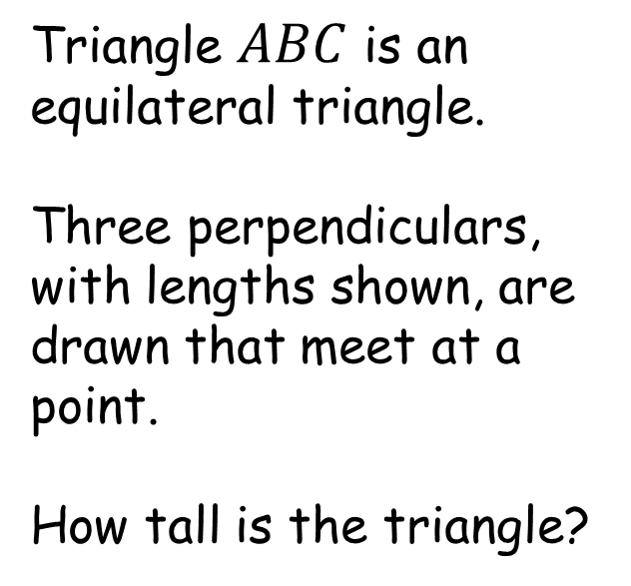

How Tall the Triangle?
$$C$$
Triangle $ABC$ is an equilateral triangle.
Three perpendiculars, with lengths shown, are drawn that meet at a point.
How tall is the triangle?
(NOT to scale)
$$4.4$$
$$3.4$$
$$5.6$$
$$A$$
$$B$$
SIC_75

Slide 30


How Tall the Triangle?
$$C$$
Triangle $ABC$ is an equilateral triangle.
Three perpendiculars, with lengths shown, are drawn that meet at a point.
How tall is the triangle?
(NOT to scale)
$$6.1$$
$$2.9$$
$$8$$
$$A$$
$$B$$
SIC_75

Slide 31


How Tall the Triangle?
$$C$$
Triangle $ABC$ is an equilateral triangle.
Three perpendiculars, with lengths shown, are drawn that meet at a point.
How tall is the triangle?
(NOT to scale)
$$9.3$$
$$3$$
$$7.7$$
$$A$$
$$B$$
SIC_75

Slide 32

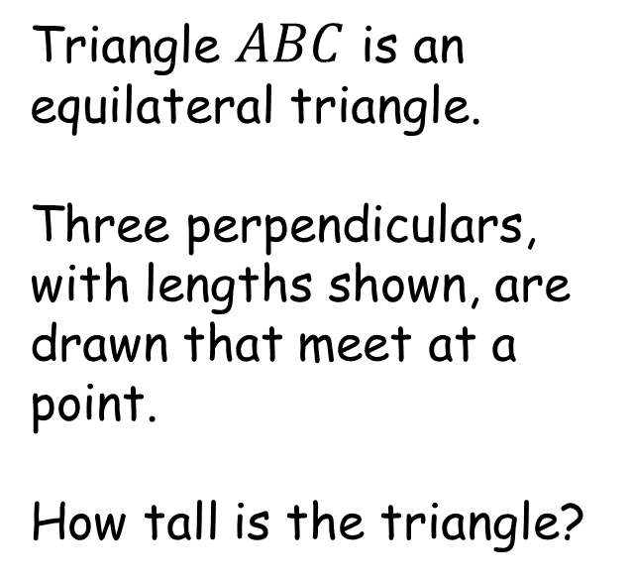

How Tall the Triangle?
$$C$$
Triangle $ABC$ is an equilateral triangle.
Three perpendiculars, with lengths shown, are drawn that meet at a point.
How tall is the triangle?
(NOT to scale)
$$10$$
$$7.5$$
$$12.5$$
$$A$$
$$B$$
SIC_75

Slide 33



How Tall the Triangle?
$$C$$
Triangle $ABC$ is an equilateral triangle.
Three perpendiculars, with lengths shown, are drawn that meet at a point.
How tall is the triangle?
(NOT to scale)
$$6.3$$
$$2.4$$
$$8.3$$
$$A$$
$$B$$
SIC_75

Slide 34

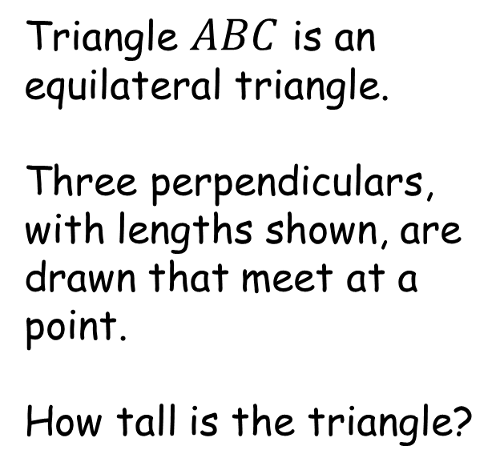

How Tall the Triangle?
$$C$$
Triangle $ABC$ is an equilateral triangle.
Three perpendiculars, with lengths shown, are drawn that meet at a point.
How tall is the triangle?
(NOT to scale)
$$3.3$$
2.2
$$5.5$$
$$A$$
$$B$$
SIC_75

Slide 35


How Tall the Triangle?
$$C$$
Triangle $ABC$ is an equilateral triangle.
Three perpendiculars, with lengths shown, are drawn that meet at a point.
How tall is the triangle?
(NOT to scale)
$$8.3$$
$$2.7$$
$$5$$
$$A$$
$$B$$
SIC_75

Slide 36


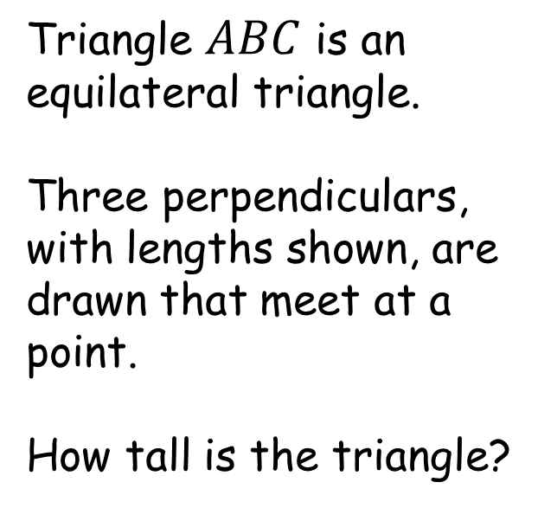
How Tall the Triangle?
$$C$$
Triangle $ABC$ is an equilateral triangle.
Three perpendiculars, with lengths shown, are drawn that meet at a point.
How tall is the triangle?
(NOT to scale)
$$11.8$$
$$8.2$$
$$12$$
$$A$$
$$B$$
SIC_75

